Slide 1
Java Data Structures and Algorithms

Slide 2
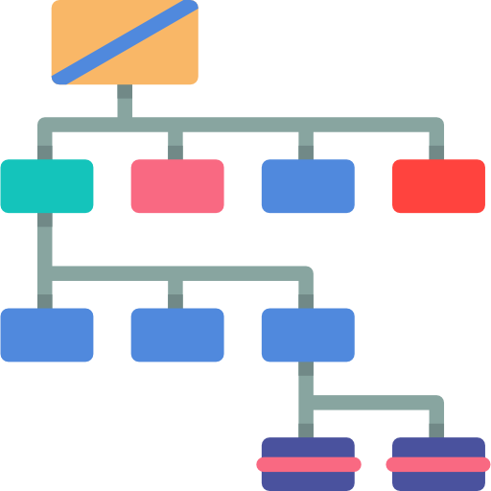
What is a Data Structure?

Slide 3
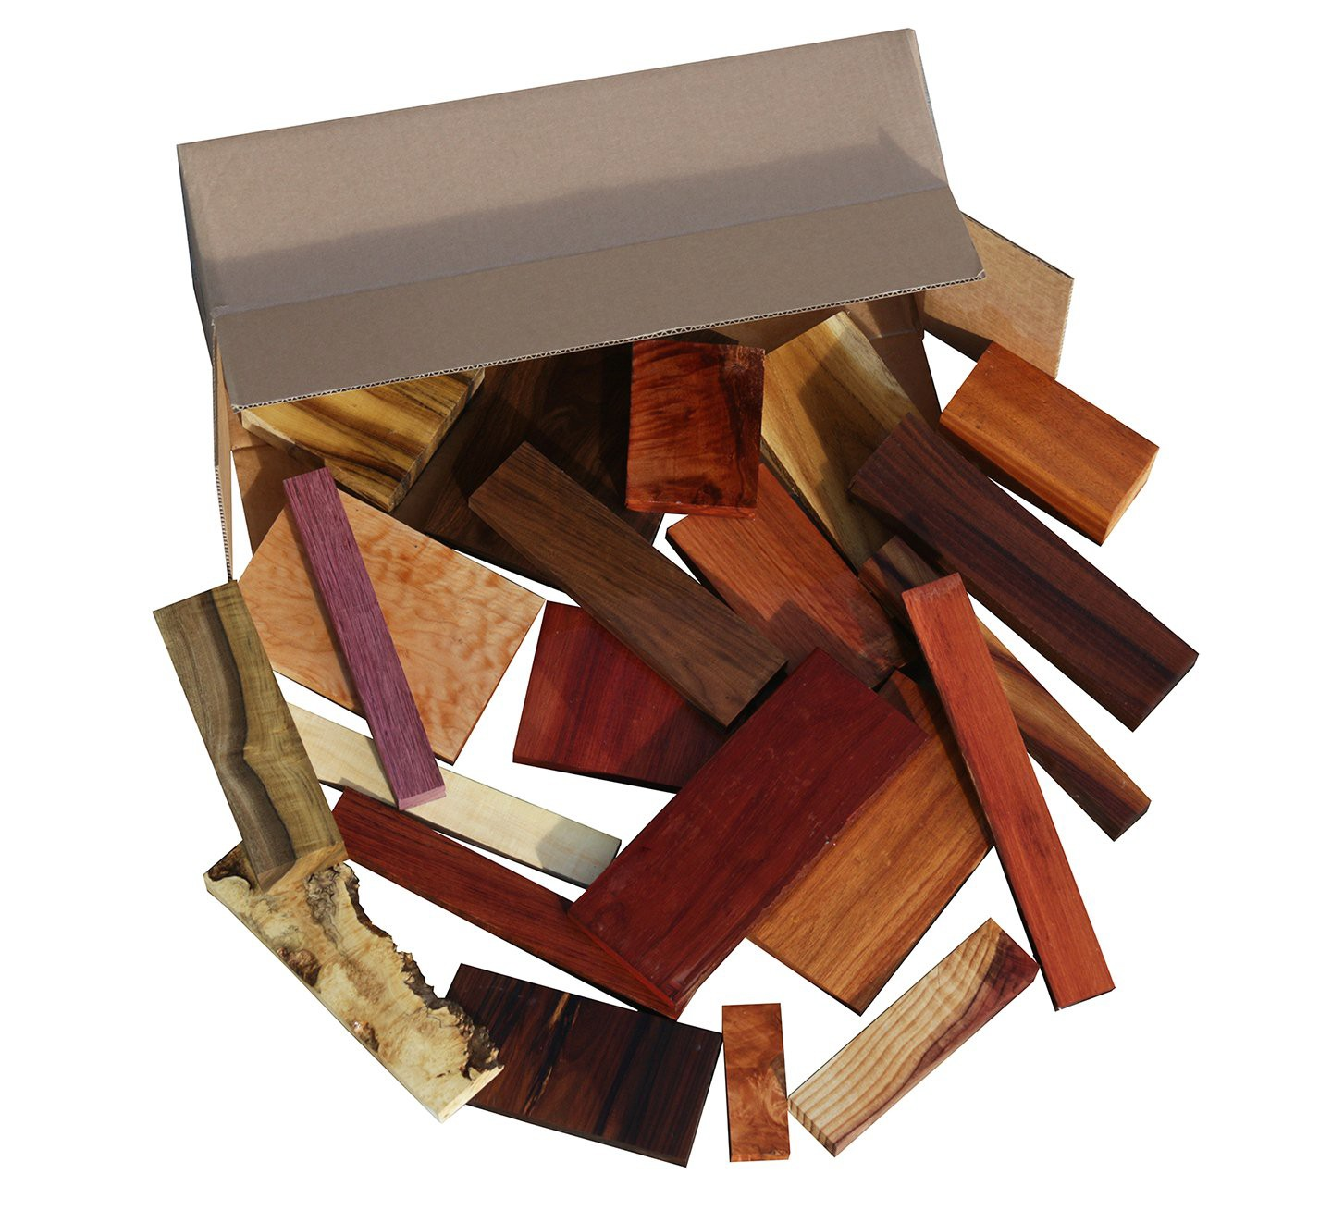
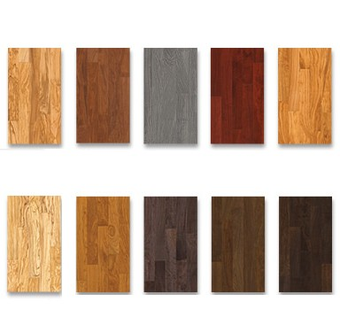
What is a Data Structure?
Data Structures are different ways of organizing data on your computer, that can be used effectively.

Slide 4

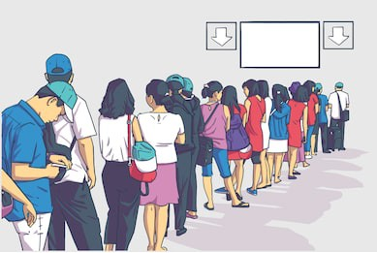
What is a Data Structure?
Data Structures are different ways of organizing data on your computer, that can be used effectively.

Slide 5
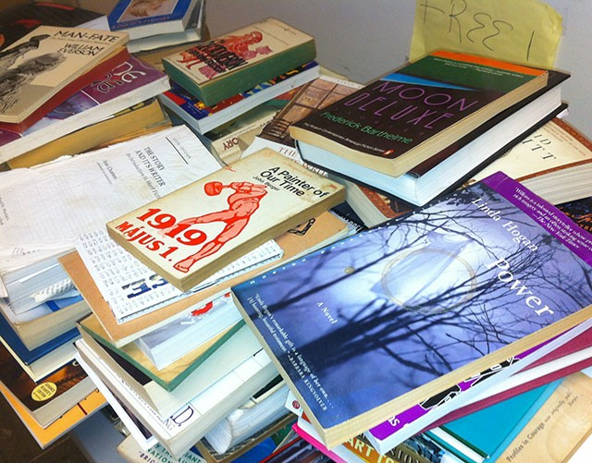

What is a Data Structure?
Data Structures are different ways of organizing data on your computer, that can be used effectively.

Slide 6
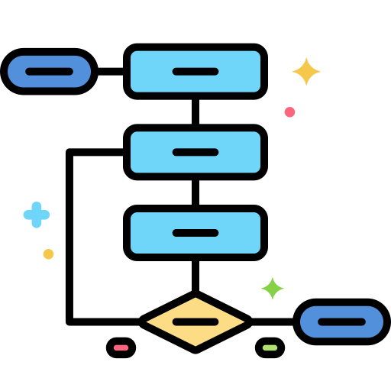
What is an Algorithm?

Slide 7
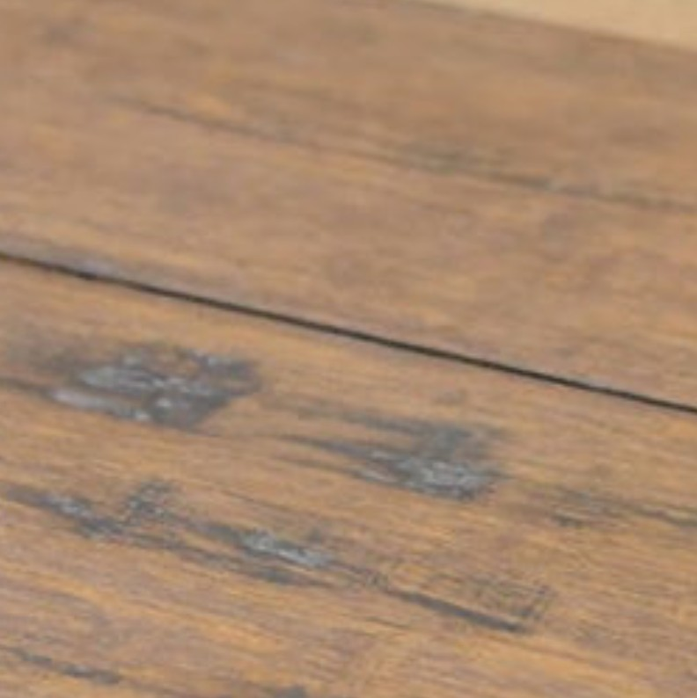
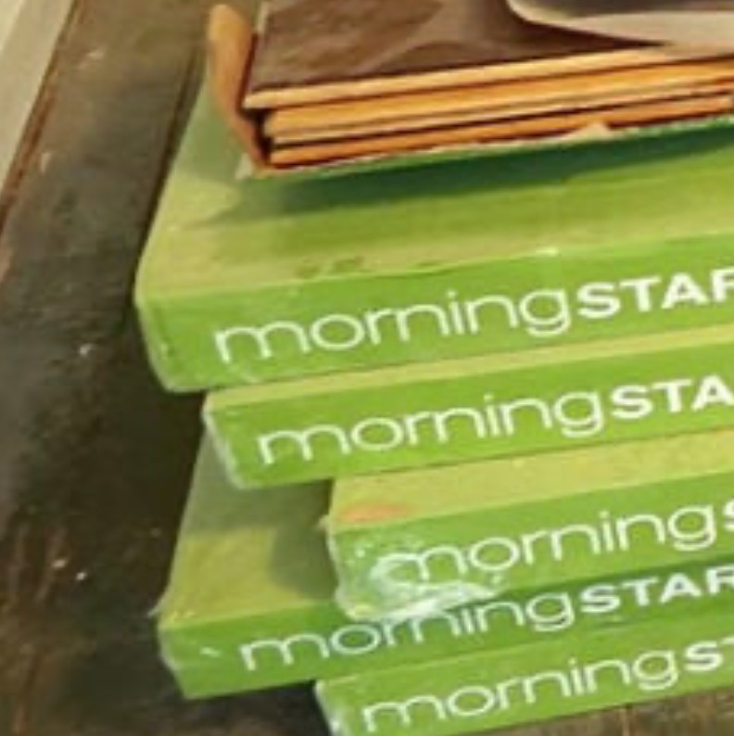

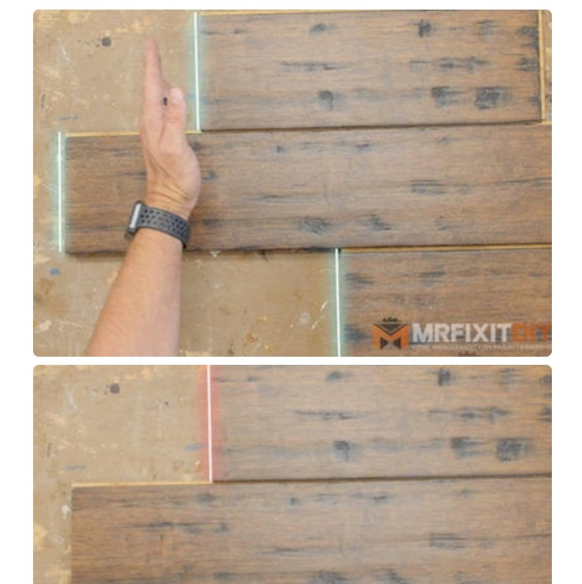

What is an Algorithm?
Set of instructions to perform a Task
Step 1: Choosing flooring
Step 2: Purchase and bring
Step 5: Trim door casing
Step 4: Determine the layout
Step 3: Prepare sub flooring

Slide 8


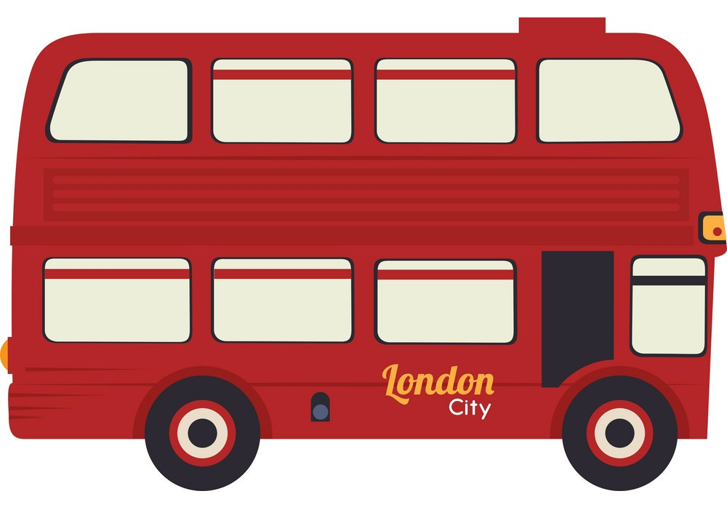
What is an Algorithm?
Algorithms in our daily lives
Step 1 : Go to bus stop
Step 2 : Take a bus Step 3: Go to office

Slide 9

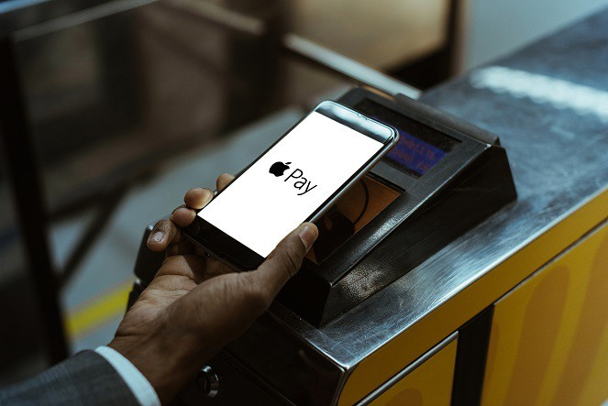
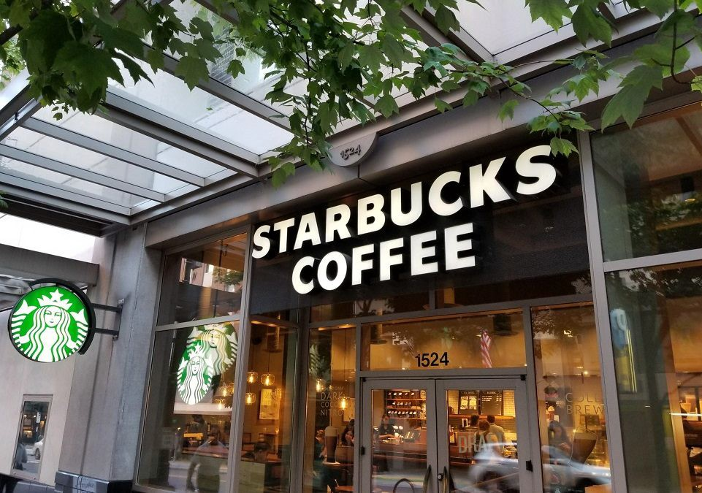
What is an Algorithm?
Algorithms in our daily lives
Step 1 : Go to Starbucks
Step 2 : Pay money Step 3: Take a coffee

Slide 10
What is an Algorithm?
Algorithms in Computer Science : Set of rules for a computer program to accomplish a Task
Input Data
Calculation
Stop when answer found

Slide 11

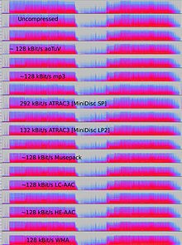
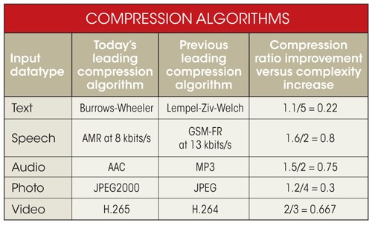

What is an Algorithm?
Sample Algorithms that are used by BIG Companies
How do Google and Facebook transmit live video across the internet?
Compression algorithms

Slide 12
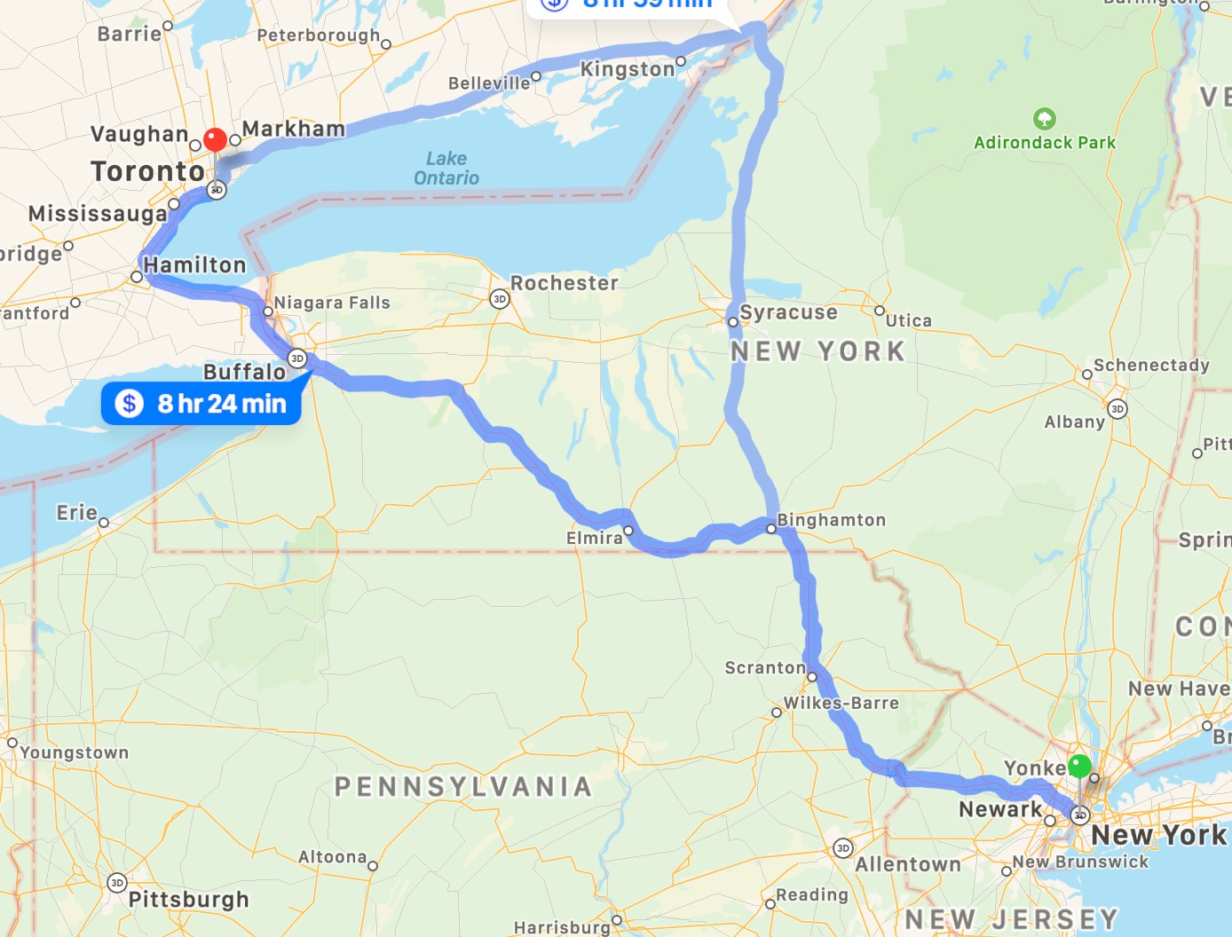
What is an Algorithm?
Sample Algorithms that are used by BIG Companies
How to find the shortest path on the map?
Graph algorithms

Slide 13
What is an Algorithm?
What makes a good algorithm?
-Correctness
-Efficiency

Slide 14

Why are Data Structures and Algorithms important?

Slide 15

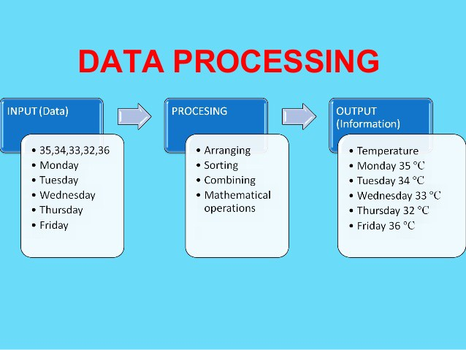
Why are Data Structures and Algorithms important?

Slide 16
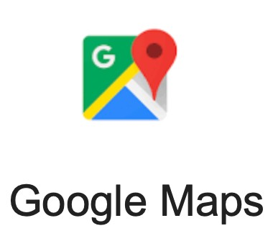
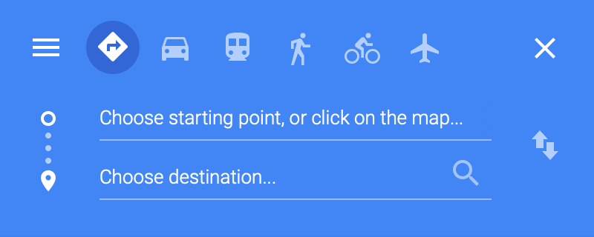

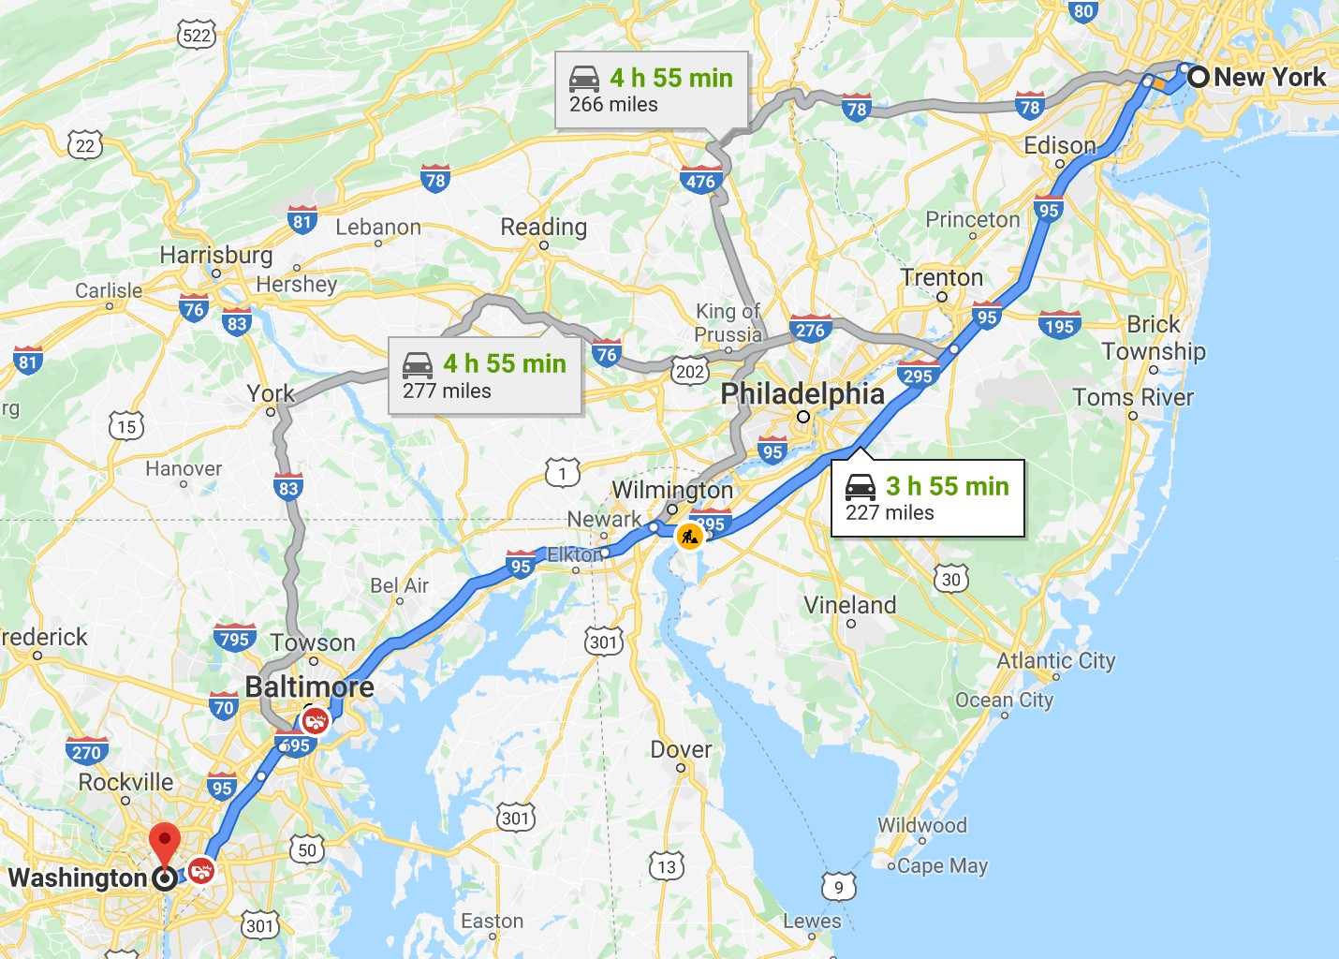

Why are Data Structures and Algorithms important?
Input data
Output
Data Structures and Algorithms
Processing

Slide 17

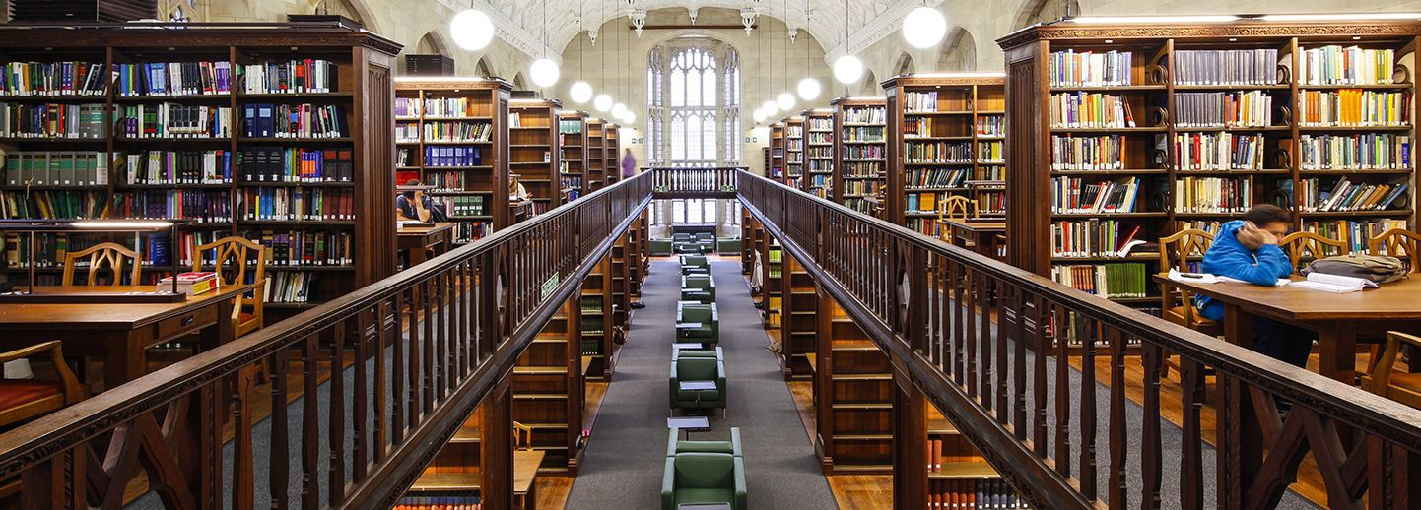


Why are Data Structures and Algorithms important?
Algorithms
COMPUTER SCIENCE
ALGORITHMS
Algorithms

Slide 18

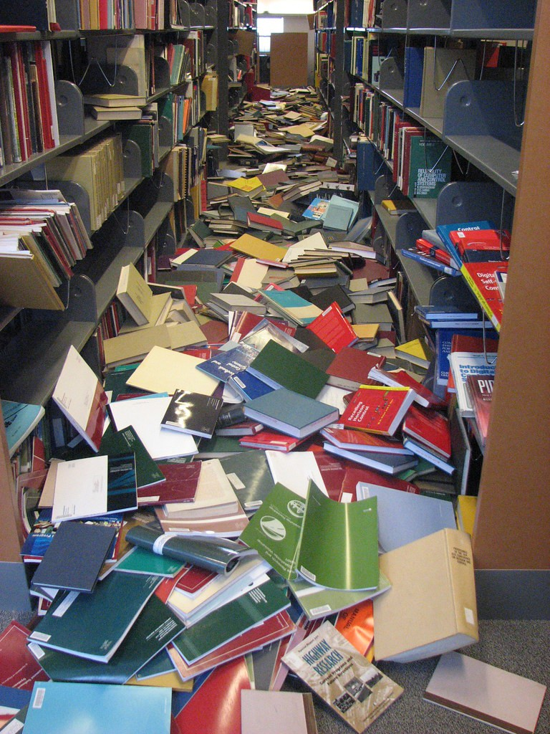
Why are Data Structures and Algorithms important?

Slide 19
Why are Data Structures and Algorithms important?
Data Structure
Data
Algorithms
COMPUTER SCIENCE
ALGORITHMS
Algorithm
Algorithms

Slide 20



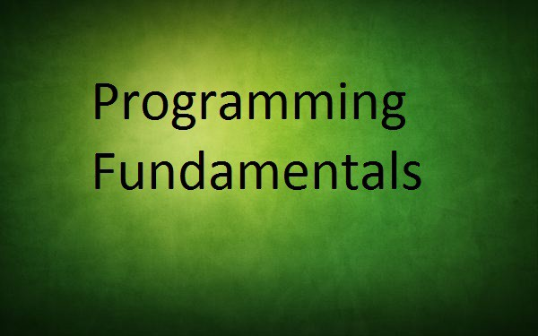
Why are Data Structures and Algorithms in INTERVIEWS?
- Problem solving skills
- Fundamental concepts of programming in limited time

Slide 21
Types of Data Structure

Slide 22
Types of Data Structure
Primitive
Non Primitive
Integer
Float
Linear
Non Linear
Character
Tree
String
Static
Dynamic
Graph
Boolean
Array
Linked List
Stack
Queue

Slide 23
Types of Data Structure
DATA STRUCTURE | Description | Example
INTEGER | Numbers with our decimal point | 1, 2, 3, 4, 5,1000
FLOAT | Numbers with decimal point | 3.5, 6.7, 6.987, 20.2
CHARACTER | Single Character | A, B, C, F
STRING | Text | Hello, Data Structure
BOOLEAN | Logical values true or false | TRUE, FALSE

Slide 24
Types of Algorithms

Slide 25

Types of Algorithms
Simple recursive algorithms
Divide and conquer algorithms
Dynamic programming algorithms
Greedy algorithms
Brute force algorithms
Randomized algorithms

Slide 26
Types of Algorithms
Simple recursive algorithms
Algorithm Sum(A, n) if n=1
return A[0] s = Sum(A, n-1) s = s + A[n-1]
return s
/* recurse on all but last */
/* add last element */

Slide 27
Types of Algorithms
Divide and conquer algorithms
Divide the problem into smaller subproblems of the same type, and solve these subproblems recursively
Combine the solutions to the subproblems into a solution to the original problem
Examples: Quick sort and merge sort
Dynamic programming algorithms
They work based on memoization
To find the best solution

Slide 28
Types of Algorithms
Greedy algorithms
We take the best we can without worrying about future consequences.
We hope that by choosing a local optimum solution at each step, we will end up at a global optimum solution
Brute force algorithms
It simply tries all possibilities until a satisfactory solution is found
Randomized algorithms
Use a random number at least once during the computation to make a decision

